Slide 1
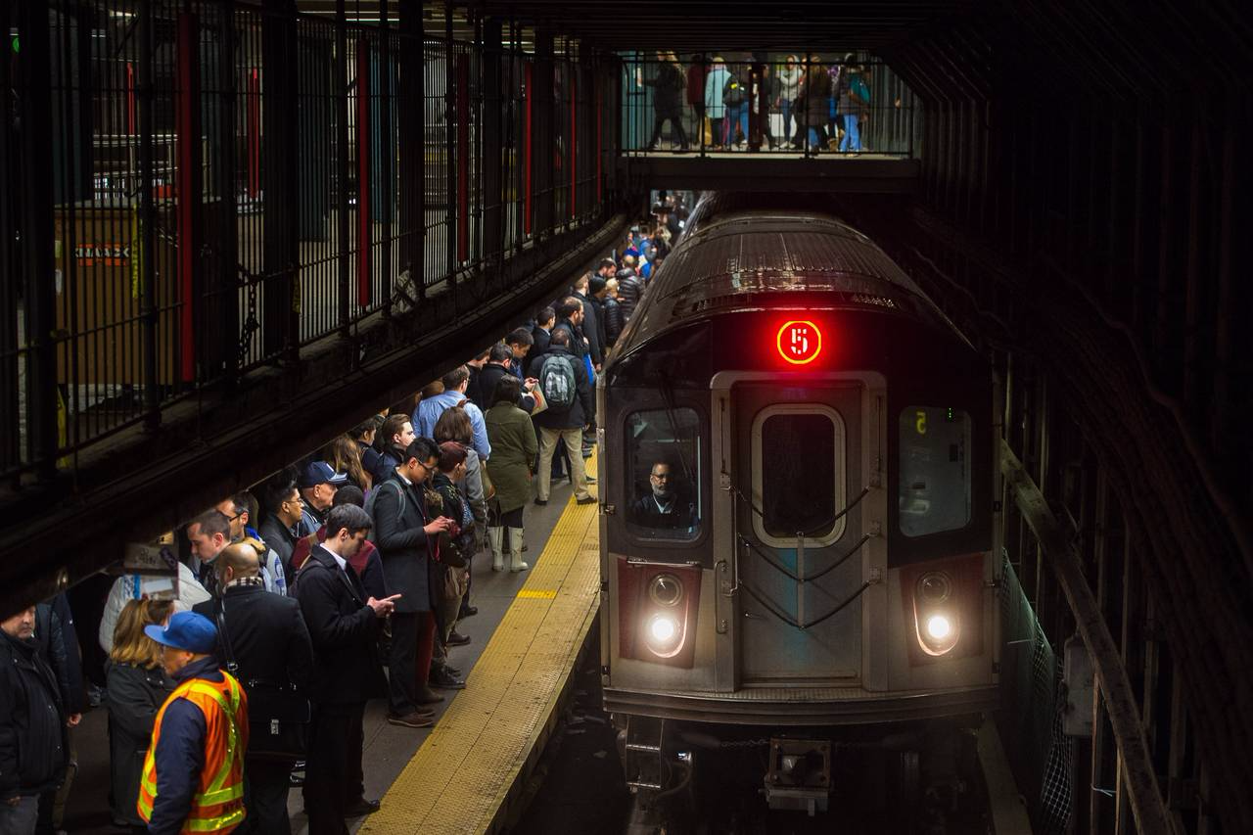
WTWY Street Team Placement Analysis
Lauren Gray
Natasha Borders
Dan Wilentz
Notes:
Introduce ourselves and the topic
Hi, we’re Lauren, Natasha and Dan
We’re here to tell you about our analysis of the NYC MTA data to help Women Tech Women Now

Slide 2
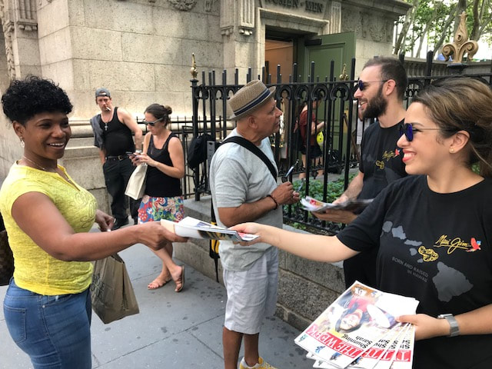


Objective
Introduction
Methodology
Results
Conclusions
Future Work
Where should WTWY place their street teams for maximum marketing payoff on weekdays?
Which subway stations have the most traffic?
When should the teams be there?
Where can teams find the most affluent people?
Notes:
Our main objectives were to determine where it’s best to position street teams for maximum marketing pay off in terms of traffic among commuters
We focused on which subway stations experience the greatest traffic
When teams should be there in terms of day and time of day
And also at which subway stations we might be most likely to find potential donors based on affluent neighborhoods

Slide 3


Methodology
Clean data
Create visualizations
Extract insights
Introduction
Methodology
Results
Conclusions
Future Work
Notes:
In our analysis we used pandas and matplotlib to clean data, create visualizations, and extract relevant insights

Slide 4
Methodology
Introduction
Methodology
Results
Conclusions
Future Work
Busiest stations
Busiest days of week
Busiest times of day
Notes:
We focused first on overall volume for all stations
Then we narrowed down our analysis to show the busiest days of week for each station
And then we zeroed in on busiest times of day

Slide 5
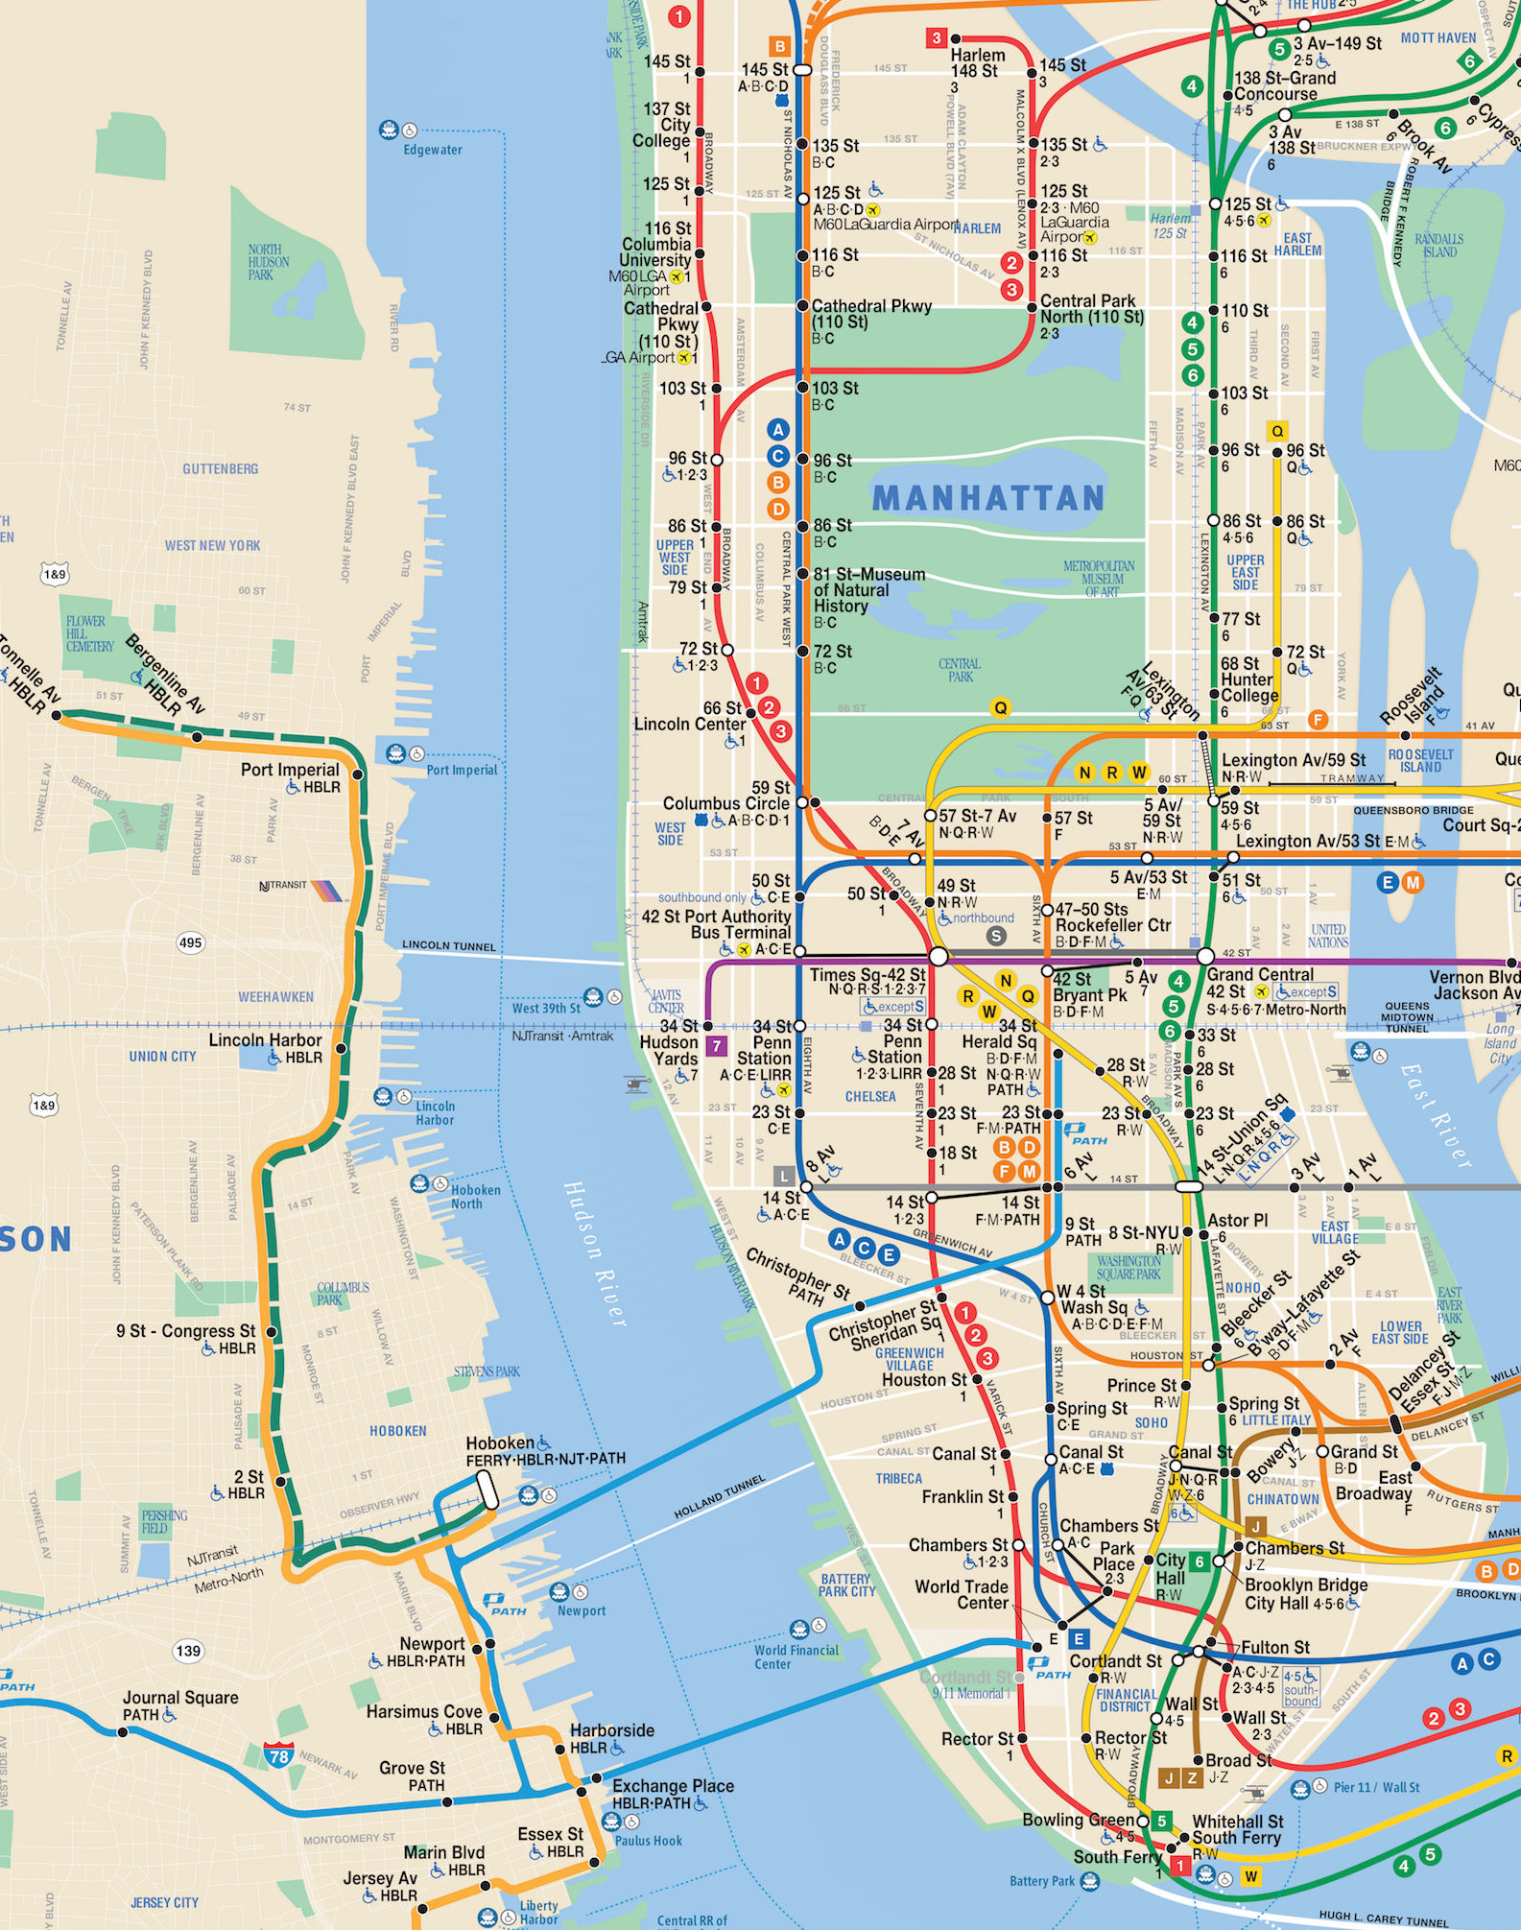
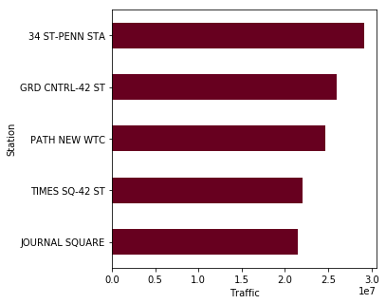
Busiest stations
Introduction
Methodology
Results
Conclusions
Future Work
Top 5 stations by traffic volume
Notes:
We found the highest traffic stations in NYC to be, unsurprisingly: Penn, GCT, WTC, TS, and JS
All are around Manhattan, except JS in Jersey City

Slide 6
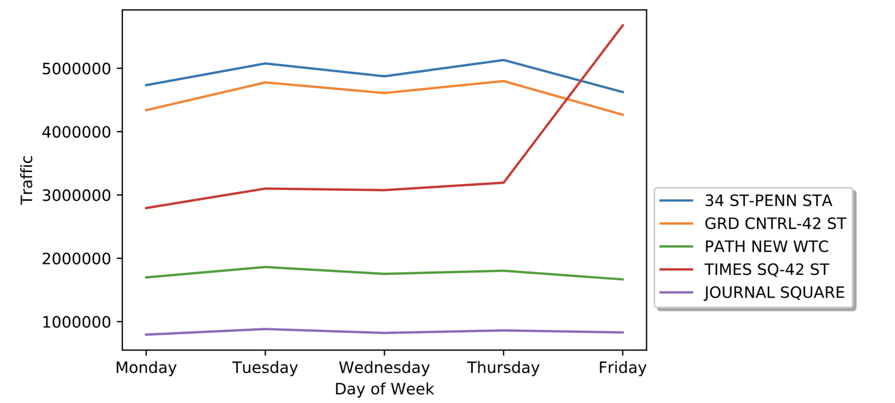
Commuter stations during the week
Introduction
Methodology
Results
Conclusions
Future Work
Notes:
Here we see how traffic varies at those top 5 stations for each day of the week
Looking at the weekdays in particular, we see some very slight peaks on Tuesdays and Thursday, so we zeroed in on those
As well as Friday increase for TS

Slide 7
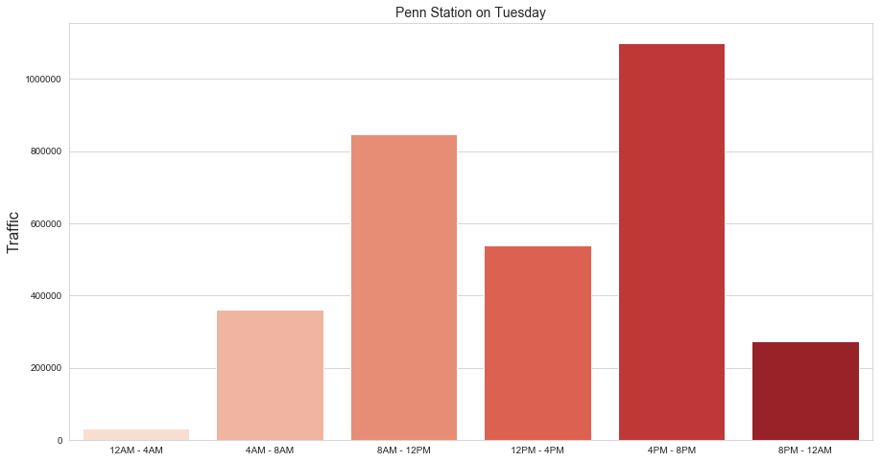
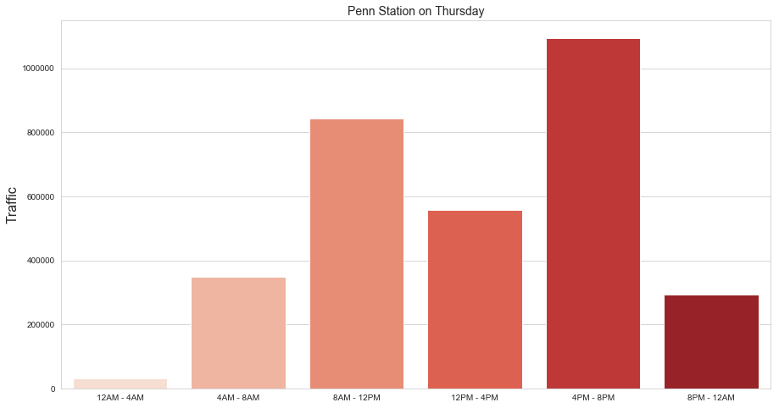
Peak traffic at Penn Station – Tuesday & Thursday
Introduction
Methodology
Results
Conclusions
Future Work
Traffic is heaviest during the morning and evening commute hours
Tuesday and Thursday show similar variation by time of day
Notes:
Here, look at traffic for different time increments throughout the day at Penn Station
We looked at Tues and Thurs, because they had slightly greater traffic than other days
Not surprisingly, we see that commuter hours during morning and evening are busiest peak times, so that’s when we recommend street teams be there

Slide 8
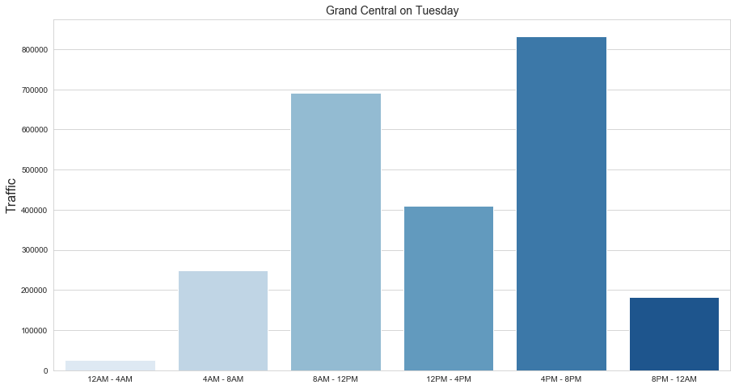
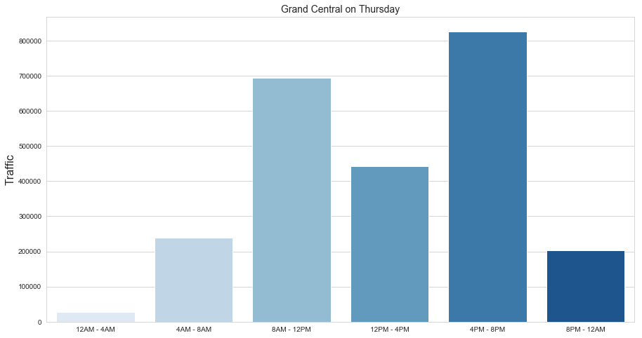
Peak traffic at Grand Central – Tuesday & Thursday
Introduction
Methodology
Results
Conclusions
Future Work
Lower overall traffic volume than Penn Station
Same trends
Notes:
Same is true for GCT, again not surprising, and reinforces recommendation to be at these two stations on Tuesdays and Thursdays

Slide 9
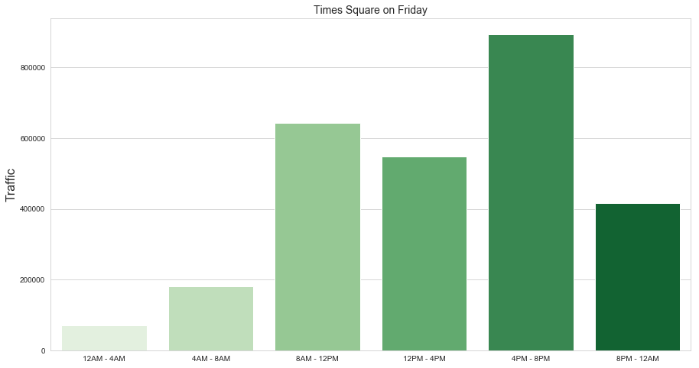
Peak traffic at Time Square – Friday
Introduction
Methodology
Results
Conclusions
Future Work
Traffic is heaviest during commuter hours
Similar profile as Penn and Grand Central stations
Notes:
We also looked at TS on Friday
Less busy than Penn and GCT, but similar traffic pattern; heavier during commuter hours, some afternoon as well
Best time to be there on Friis evening commute (4-8pm)

Slide 10
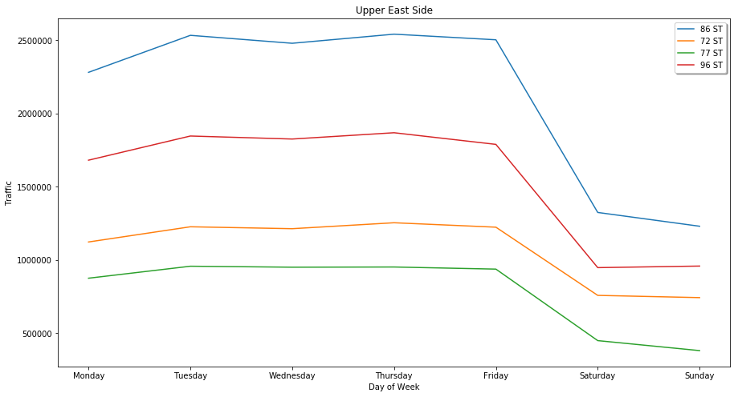
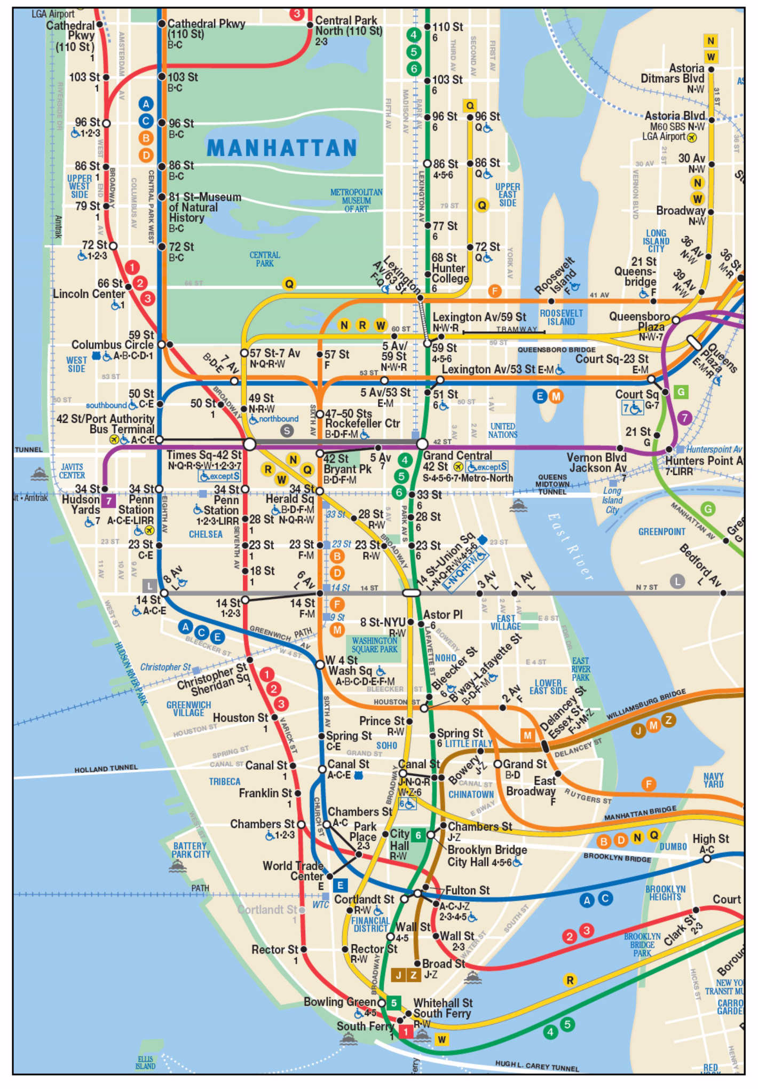
Highest income neighborhood in NYC
Introduction
Methodology
Results
Conclusions
Future Work
Upper East Side/Carnegie Hill: mean household income = $311,109
Busiest station: 86th Street
Notes:
Aside from just looking at traffic volume based on subway data, we also thought it would be beneficial to narrow in on high income neighborhoods in NYC where you will more likely find people wiling to donate or buy gala tickets
We chose to look at the highest income neighborhood, Upper East Side
In this neighborhood, we see a very high level of commuter traffic during the week, so that is prime time for street teams
Because peak values in the upper eastside neighborhood are relatively similar throughout the week, we narrow in here on Wednesday so you have a station to visit that day
https://ny.curbed.com/2017/6/27/15881706/nyc-richest-neighborhoods-manhattan-brooklyn

Slide 11
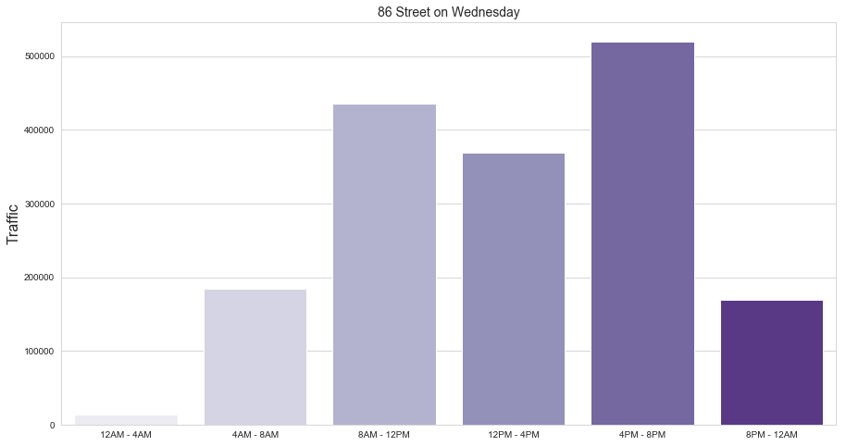
Peak traffic at 86th Street – Wednesday
Introduction
Methodology
Results
Conclusions
Future Work
Traffic is heaviest during commute times (primarily evening) and lunch hours
Notes:
We look specifically on Wednesday since no rec that day yet
Good day to go to upper east side and cater to commuters there during commuter hours – morning, evening, and almost as good during lunch hours

Slide 12
Recommendations:
Introduction
Methodology
Results
Conclusions
Future Work
For peak traffic during morning and evening commute hours (8am-12pm; 4pm-8pm):
Tuesday: Penn Station & Grand Central Station
Thursday: Penn Station & Grand Central Station
Friday: Time Square
Target potential donors in affluent neighborhoods
Wednesday: Upper East Side
Notes:
So our main recs are to focus on peak traffic during morning and evening – commuter hours at stations – Penn, Gct
Friday happy hour TS
Weds take a break, go to upper east side
Mon take a day off
Conclusions
Focus on weekday commuting hours and target heavy traffic areas such as Penn and Grand Central Station + Times Square
Target the affluent consumers by focusing on the neighborhoods of Upper East Side

Slide 13

Future work
Introduction
Methodology
Results
Conclusions
Future Work
Look into the areas with heavy concentrations of technology companies and women-owned businesses
Examine weekend data for more insights
Dive deeper into the affluent neighborhoods data
Notes:
In the future, we will…

Slide 14
Thank you! Questions?
Introduction
Methodology
Results
Conclusions
Future Work

Slide 15
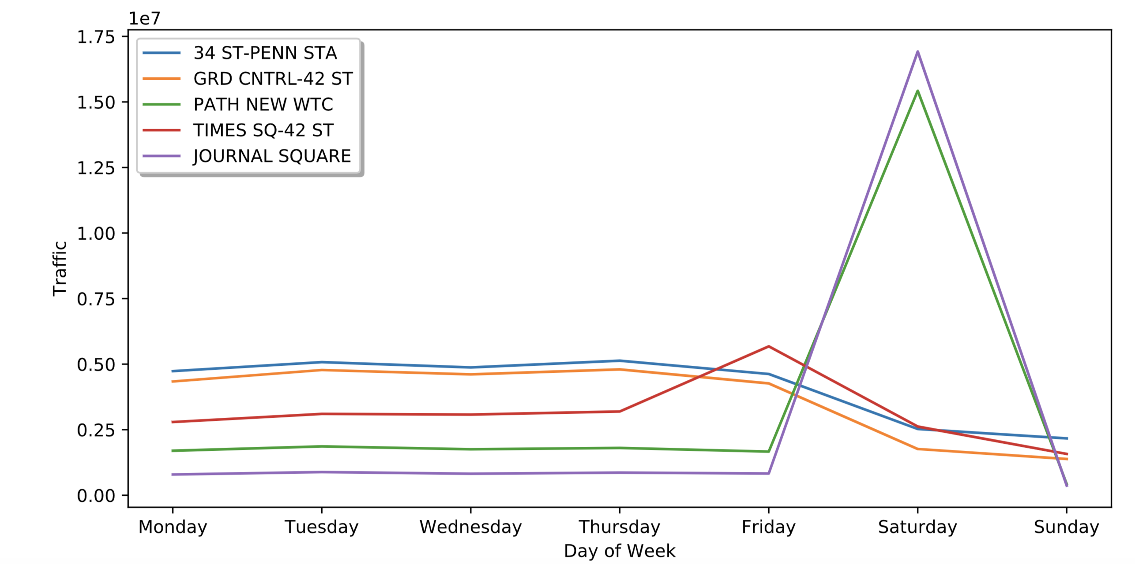
Busiest days by station
Introduction
Methodology
Results
Conclusions
Future Work
Notes:
Looking at those 5 top stations by day of week we see that some are busier during weekdays, such as GCT and Penn
And some are busiers on weekends, such as JS and WTC
Here we show traffic by day of week

Slide 16
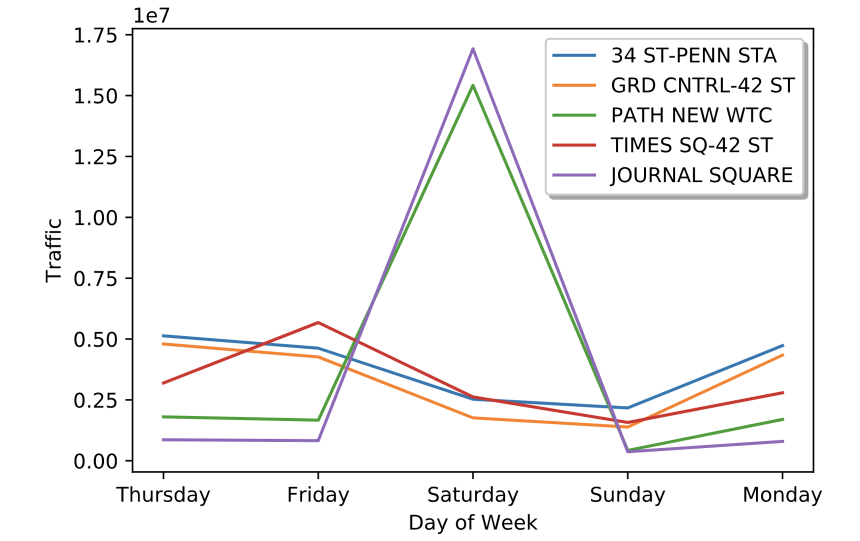
Weekend traffic
Introduction
Methodology
Results
Conclusions
Future Work
Heavy weekend traffic at major transfer stations
Considerable spike in traffic relative to weekdays
Notes:
Then we looked at weekend traffic patterns
Shows that WTC and Journal square has quite a lot of volume on sat, so could be a good place for weekends
But we are assuming for analysis that street teams only work on weekdays, so for now we will just focus on weekdays recs
Here we show traffic by day of week

Slide 17
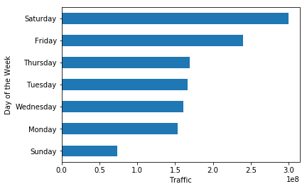
Traffic by day of week
Introduction
Methodology
Results
Conclusions
Future Work
Notes:
Here we will explain these are the top 10 stations by traffic volume and where they are located on the subway map
It is not surprising that Penn, GCT, Times Square, etc. were among the busiest stations
- Scientific notation on y axis
- Borders on the bars
- Gridlines
- Titles, axis labels
- X axis should be categorical
- Different color

Slide 18
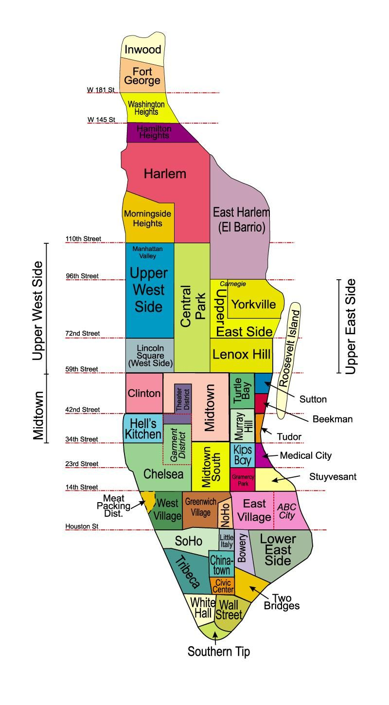
Highest income neighborhoods in NYC
Introduction
Methodology
Results
Conclusions
Future Work
Upper East Side/Carnegie Hill: $311,109
Soho/Tribeca/Civic Center/Little Italy: $235,555
Turtle Bay/East Midtown: $196,721
Notes:
To further support our analysis, we looked at highest income neighborhoods in NYC
We saw that uppereast side, soho, and midtown east have highest mean household incomes
So we looked at upper east
Richest neighborhoods in New York City (based on data, but I’m struggling to find the original census data)
https://ny.curbed.com/2017/6/27/15881706/nyc-richest-neighborhoods-manhattan-brooklyn

